Slide 1
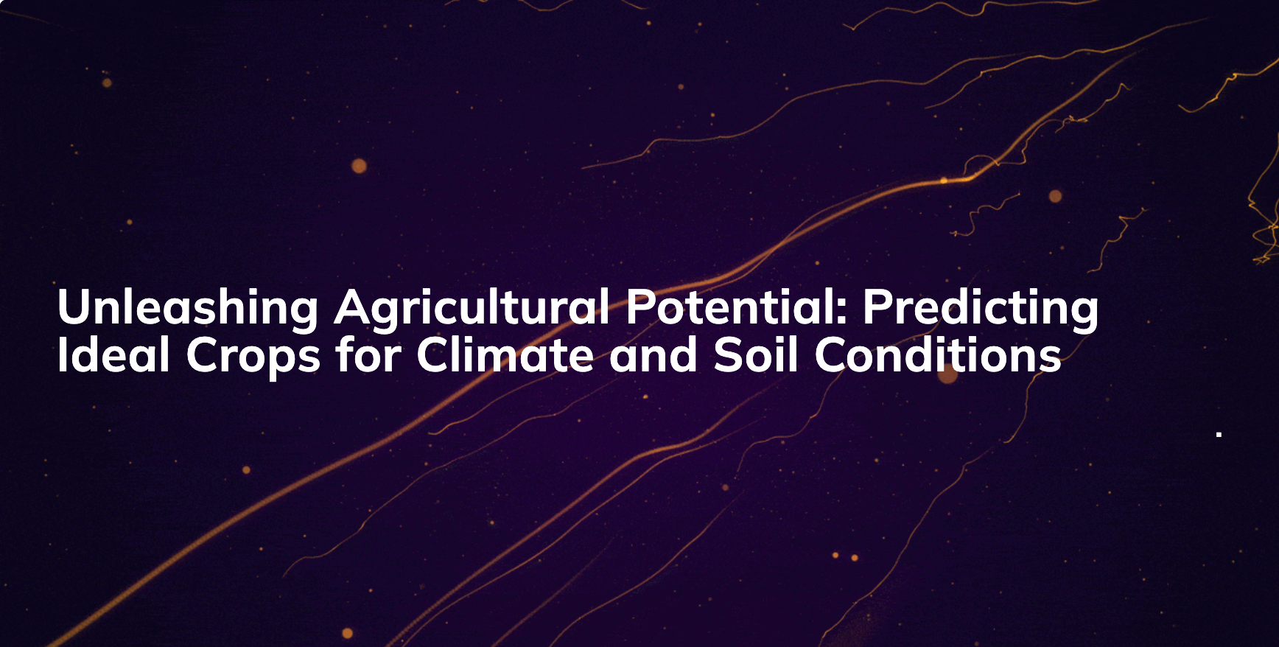

Slide 2


Slide 3
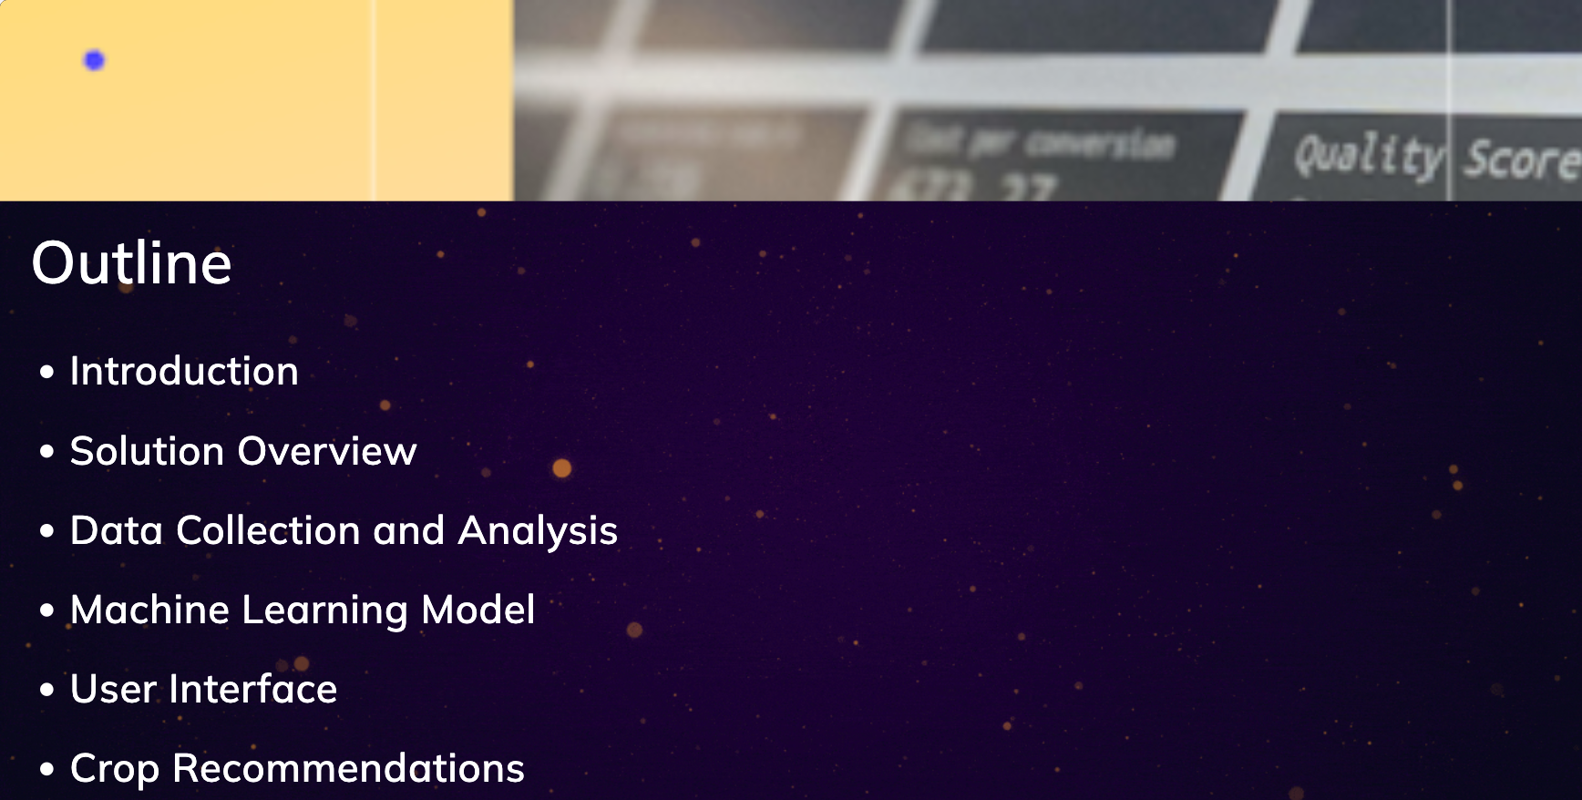

Slide 4
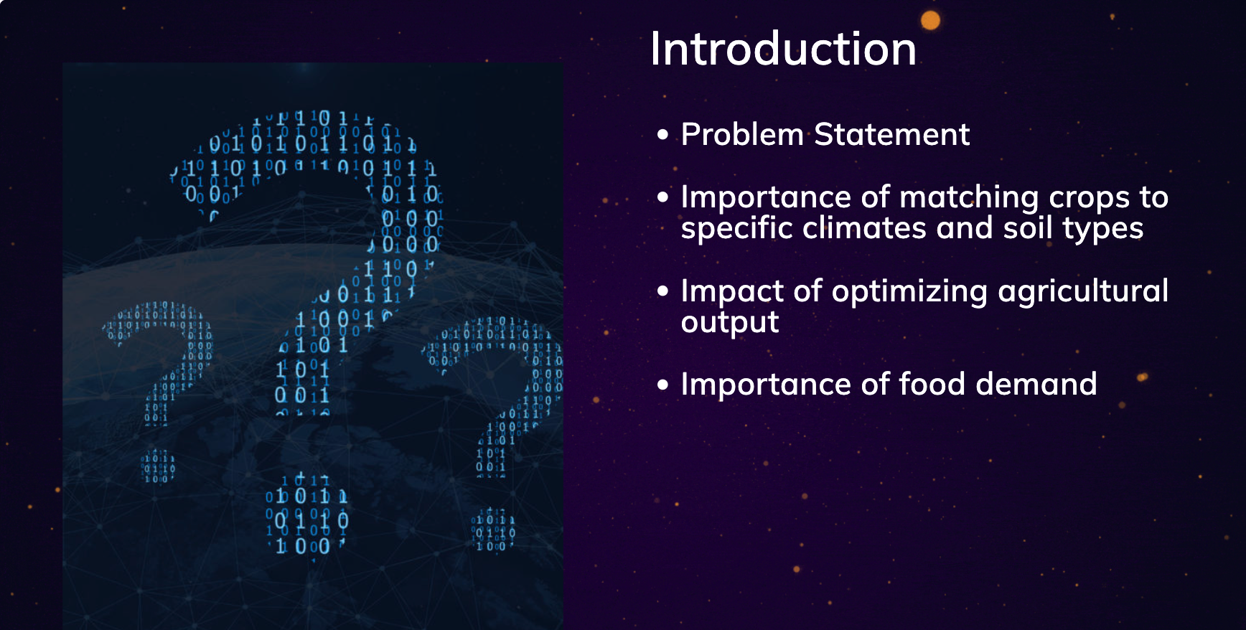

Slide 5

Optimizing Crop Based on Climate and Soil Conditions
Objective: To maximize agricultural yield and sustainability by recommending crops best suited for specific environmental conditions.

Slide 6

Our Innovative Solution
Predictive Model: Utilizes machine learning algorithms for accurate recommendations.
Input Data: Climate, soil type, historical yield data, and market demand trends.
Output: Personalized crop suggestions, yield projections, and market demand estimates.

Slide 7
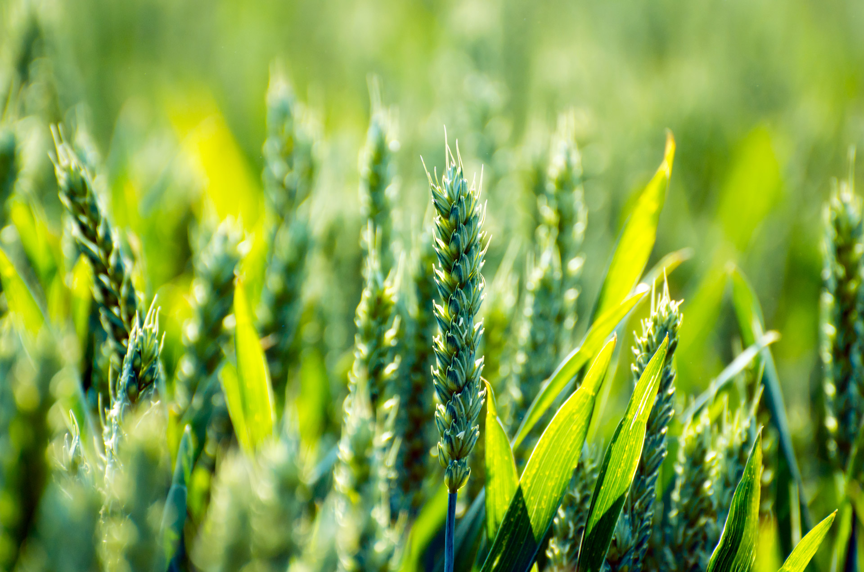
Crop Recommendations
Example 1: Region A (Mediterranean Climate)
Recommended Crops: Olive, Citrus fruits
Yield Projection: 15% increase compared to previous season
Market Demand: High demand for organic citrus products
Example 2: Region B (Loamy Soil, Temperate Climate)
Recommended Crops: Wheat, Potatoes, Sunflowers
Yield Projection: 20% increase compared to previous season
Market Demand: Stable market for wheat and potatoes

Slide 8
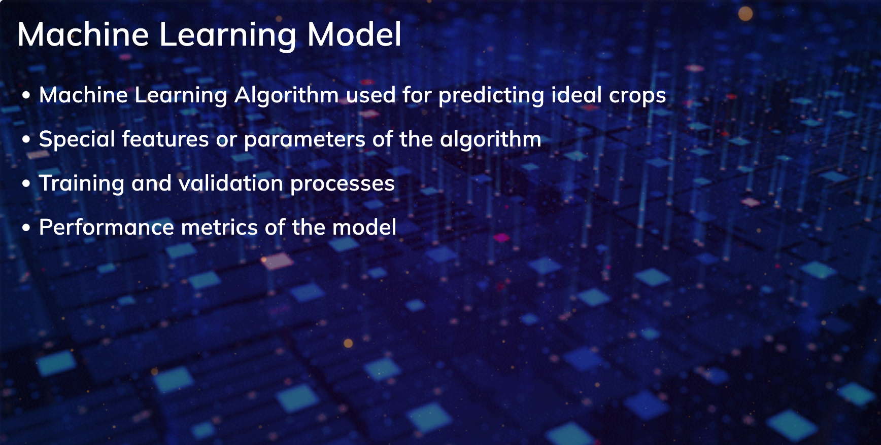

Slide 9
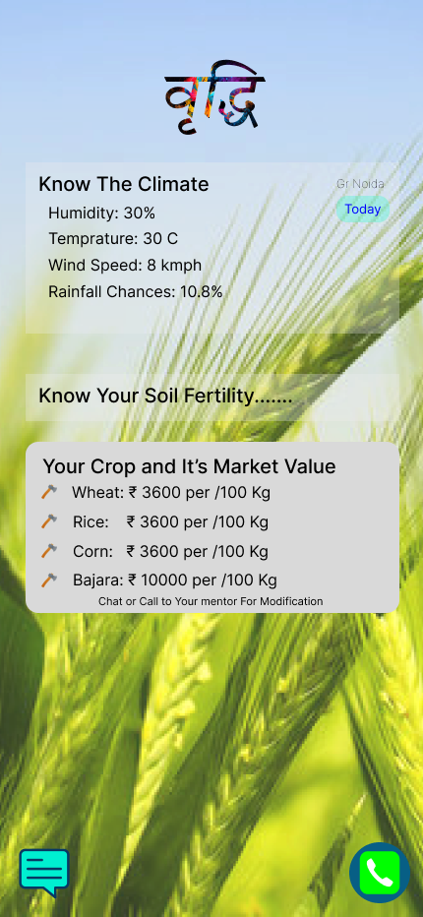
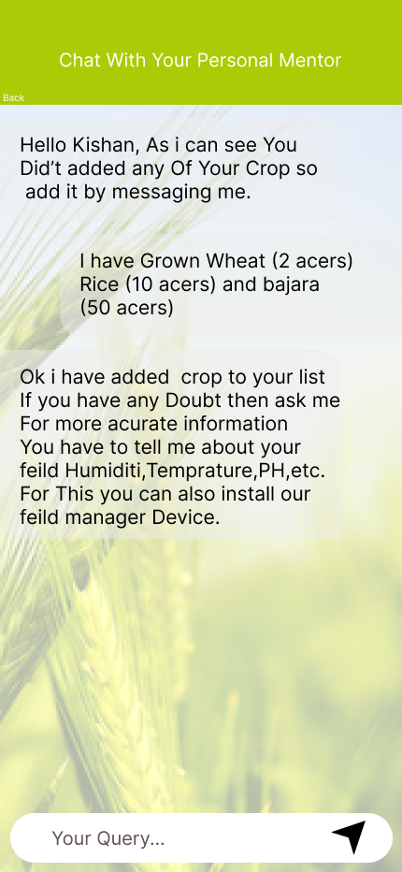


Our Prototype Design

Slide 10
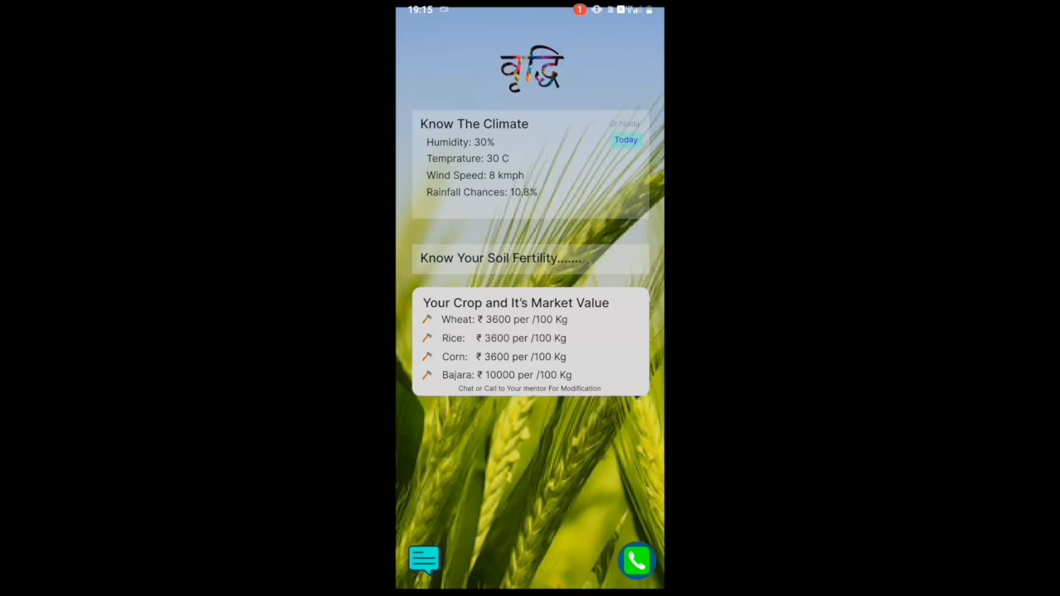
Our Prototype Demo

Slide 11


